Slide 1

Department of Computer Science and Engineering CSB4243 – DESIGN PROJECT 1 Title of the Project Review-0/1/2/3
Name 1 roll no
Name 2 roll no
SUPERVISORS
Dr.R.Krishnaveni, Professor
Dr.S.Sathyalakshmi, Professor

Slide 2
Agenda for Review 0
Abstract
Introduction
Goals and Motivation
Literature review/Existing Systems
Problem Definition
Objective
Contribution of Team members
References

Slide 3
Agenda for Review 1
Abstract
Introduction
Goals and Motivation
Literature review/Existing Systems
Problem Definition
Objective
Proposed System/Work
Architecture Diagram
Contribution of Team members
References

Slide 4
Agenda for Review2
Introduction
Goals and Motivation
Literature review/Existing Systems
Problem Definition
Objective
Proposed System/Work
System Requirement
Architecture Diagram
Module List
Modular Description
Implementation
Screenshots
Contribution of Team members
References

Slide 5
Agenda for Review 3
Introduction
Goals and Motivation
Literature review/Existing Systems
Problem Definition
Objective
Proposed System/Work
Architecture Diagram
Module List
Modular Description
Result and Discussion
Conclusion and Future Work
Screenshots
Contribution of Team members
References

Slide 6
Abstract
Abstract should provide the answer to the following questions:
1.What is the problem that you are planning to solve?
2. What is limitation and why do you want to solve the problem? Mention the societal impact, if applicable for your project
3. How do you want to solve the problem?
4. What methods/ components are you planning to use to solve the problem?
5. Justify the selection of methods/ components.

Slide 7
Introduction

Slide 8
Goals and Motivation

Slide 9
Literature review/Existing Systems
S.No | Title of the paper/System | Authors | Publication (Name of the Journal/Conference proceedings with Year) | Algorithm/Methodology adopted | Limitations

Slide 10
Problem Definition

Slide 11
Objective

Slide 12
Proposed System/Work

Slide 13
Contribution of Team members

Slide 14
References
JOURNAL ARTICLE: WITH SINGLE AUTHOR
[1] Waldron, S. (2008). Generalized Welch bound equality sequences are tight frames. IEEE Transactions on Information Theory., 49(9), 2307 – 2309.
JOURNAL ARTICLE: WITH TWO AUTHORS
[2] Habeeb, M., & Sugumaran, A. (2022). Strategies of cell signaling and critical focus on etiology of hepatocellular carcinoma. Biointerface Research in Applied Chemistry, 12(4), 5187-5198. doi:10.33263/BRIAC124.51875198
JOURNAL ARTICLE: WITH MORE THAN TWO AUTHORS
[3] Grady, J. S., Her, M., Moreno, G., Perez, C., & Yelinek, J. (2019). Emotions in storybooks: A comparison of storybooks that represent ethnic and racial groups in the United States. Psychology of Popular Media Culture, 8(3), 207– 217.
REFERENCE TO CONFERENCE PAPERS, PAPERS IN COMPILED CONFERENCE PROCEEDINGS:
[4] Datta, A., Yadav, O. K., Singh, Y., Sountharrajan, S., Karthiga, M., & Suganya, E. (2021). Real-time face swapping system using OpenCV. Paper presented at the Proceedings of the 3rd International Conference on Inventive Research in Computing Applications, ICIRCA 2021, 1081-1086. doi:10.1109/ICIRCA51532.2021.9545010

Slide 15
General Instructions
All slides to be numbered except title slide.
All figures should be numbered
All tables should be numbered
Follow the same ppt layout.
Use Times new roman as font style and minimum font size as 24 for the contents of the ppt.

Slide 16
Sample Table format
Table 2: Security services of public key cryptographic techniques
Security Parameters | Public-key Cryptographic Models
Data integrity | Digital Signature
Confidentiality | Encryption and Decryption models
Authentication | Digital Signature
Non-repudiation | Digital Signature

Slide 17
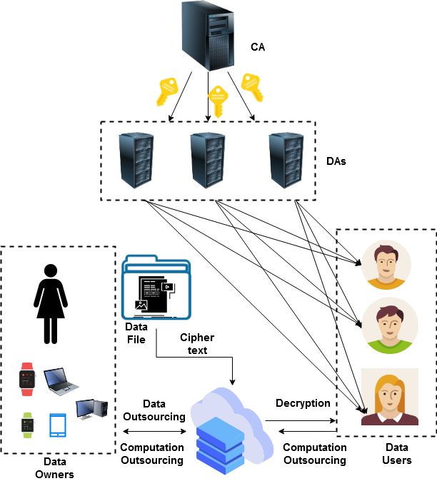
Sample Figure
Figure 2: Secured data storage and retrieval using the light-weight cryptography mechanism

Slide 18
THANK YOU

